Slide 1
eLearning Platform
-By Team Effin’a

Slide 2
Introduction
Its An assisted LMS application designed for school and prep students.
The Application will consist an integrated learning module and will provide performance based analytics and a doubt clarification platform.

Slide 3
Features
Doubt clarification section for students.
This application shows the analytics of the students test and using that student can evaluate themselves.
Learning modules include reference notes and sample papers.
It displays detailed class analytics of the student.
You can find the top quality practice questions for the student to improve his ability in problem solving.
It has a unique ranking system for the tests/exams.

Slide 4
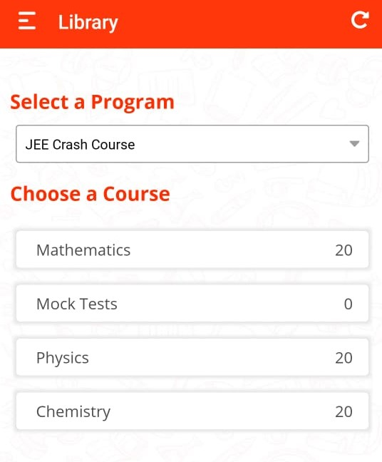
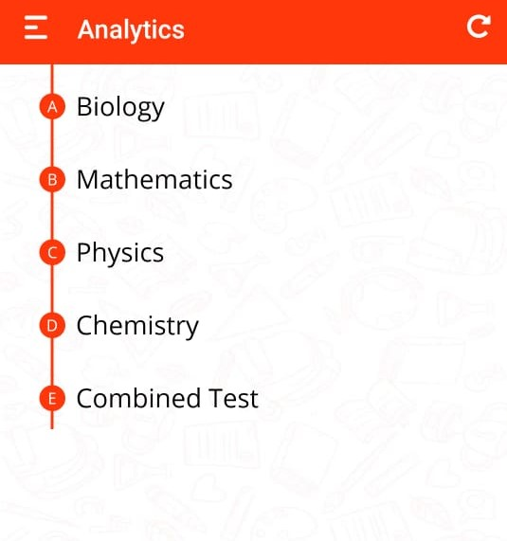
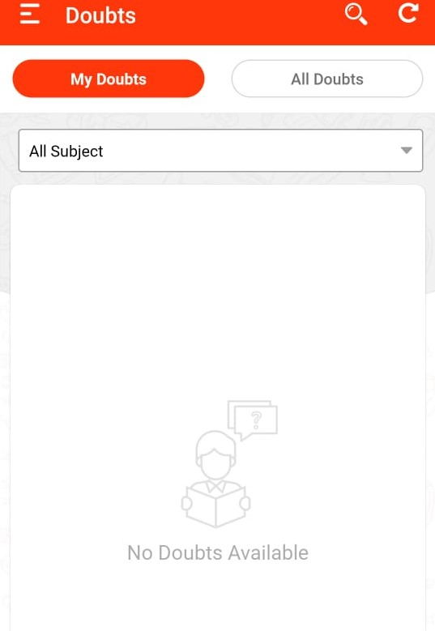
Sample Interface

Slide 5
Presentation by “Team Effin’a” Saumitra Topinkatti (+91 7022 367 638) Tushar Upari Parishkar Singh Ritesh Ravi

